Slide 1
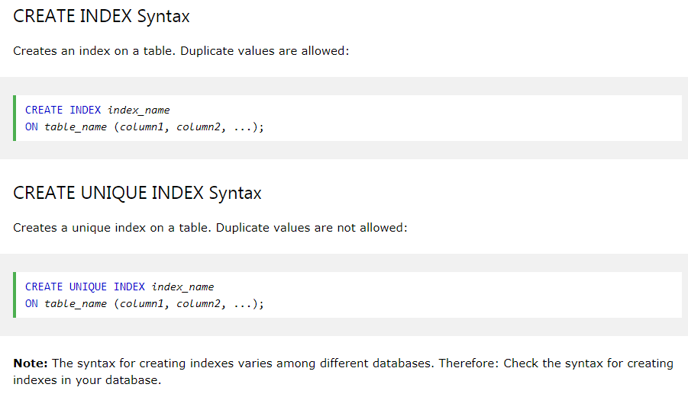
SQL CREATE INDEX Statement
The CREATE INDEX statement is used to create indexes in tables.
Indexes are used to retrieve data from the database more quickly than otherwise. The users cannot see the indexes, they are just used to speed up searches/queries.
Updating a table with indexes takes more time than updating a table without (because the indexes also need an update). So, only create indexes on columns that will be frequently searched against.

Slide 2
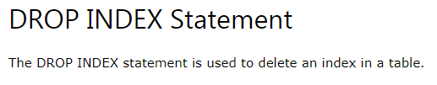

SQL CREATE INDEX Statement
Examples
CREATE INDEX idx_age
ON employee (AGE);
ALTER TABLE employee
DROP INDEX idx_age;
CREATE INDEX idx_age_salary
ON employee (AGE, SALARY);

